Slide 1


YIELD PULSE
Presented By :
Guided By :
Dr.Sapana k
Department of AI&ML
ABHISHEK (1VI21AI001)
ADISHESHA (1VI21AI002)
ARUL VENGADESWARA(1VI21AI009)

Slide 2
Agenda
01
ABSTRACT
02
PROBLEM DEFINITION
03
OBJECTIVES
04
LITERATURE SURVEY
05
METHOLOGY OF EXPECTED OUTCOME
06
REFERENCES

Slide 3
ABSTRACT
Nutrient Analysis: YieldPulse analyzes critical nutrient levels in crops, providing real-time feedback on whether elements like nitrogen, phosphorus, and potassium are within optimal ranges. This helps in maintaining soil health and maximizing crop yield.
Machine Learning Integration: Utilizing advanced machine learning techniques, YieldPulse predicts crop yields based on historical data, seasonal variations, and current agricultural practices. This empowers farmers to make data-driven decisions, optimizing their resources and increasing productivity.
Tailored Solutions: YieldPulse offers personalized recommendations for fertilizer usage and crop management based on the specific needs of the farm and crop type. By addressing nutrient deficiencies and excesses, it helps in reducing waste and enhancing the efficiency of agricultural practices.

Slide 4
PROBLEM DEFINITION
Nutrient Imbalance :Farmers often struggle with maintaining optimal nutrient levels in their soil, leading to reduced crop yields and soil degradation.
Inaccurate Yield Predictions :Traditional methods of predicting crop yields are often imprecise, resulting in inefficient resource allocation and financial losses.
Lack of Customized Agricultural Advice :Many farmers lack access to tailored recommendations for fertilizer use and crop management, leading to suboptimal farming practices and lower productivity.
MACHINE LEARNING

Slide 5
OBJECTIVES
Optimize Nutrient Management :Provide real-time analysis of soil nutrient levels to ensure crops receive the precise nutrients they need for optimal growth and health.
Enhance Yield Prediction :Utilize machine learning algorithms to accurately predict crop yields, helping farmers plan and allocate resources more effectively.
Promote Efficient Fertilizer Use :Offer data-driven recommendations for fertilizer application, reducing waste, cutting costs, and minimizing environmental impact.
Deliver Customized Agricultural Solutions :Tailor recommendations to the specific needs of different crops, soils, and regions, improving overall farm productivity and sustainability.
MACHINE LEARNING

Slide 6
LITERATURE SURVEY
2023
2022
2021
2024
FEBRUARY
JULY
SEPTEMBER
JANUARY
.
2023
2022
2022
2021
JUNE
NOVEMBER
MARCH
MAY

Slide 7
LITERATURE SURVEY
[1] V.C. Waikar, S.Y. Thorat, A.A. Ghute, P.P. Rajput, M.S. Shinde “IoT and Machine Learning-Based Soil Quality and Crop Yield Prediction” International Research Journal of Engineering and Technology, Volume 9, Issue 3, Pages 190-205, January 2024.
Advantages:
Combines IoT and machine learning for enhanced accuracy.
Provides actionable insights for soil and crop management.
Can help in resource conservation and cost savings.
Disadvantages:
Integration of IoT and machine learning requires technical expertise.
High implementation and maintenance costs.
Potential challenges in ensuring data quality and consistency.
01
02
03
04

Slide 8
LITERATURE SURVEY
[2] P. Rao, N. Reddy Machine Learning for Soil Fertility and Crop Yield Prediction
International Conference on Agricultural Technologies, Pages 140-150, June 2023
Advantages:
Predicts soil fertility and crop yield accurately.
Helps in planning and optimizing fertilizer use.
Can adapt to different environmental conditions.
Disadvantages:
Needs comprehensive data collection over time.
Complexity in setting up and maintaining machine learning models.
Risk of model errors affecting predictions and recommendations.
01
02
03
04

Slide 9
LITERATURE SURVEY
[3] M. Singh, R. Verma Real-Time Soil Quality Analysis and Fertilizer Advances in Agricultural Sciences, Volume 15, Issue 1, Pages 23-40, February 2023.
Advantages:
Offers real-time analysis and recommendations.
Increases efficiency in fertilizer usage.
Can be integrated with other agricultural management systems.
Disadvantages:
Dependence on stable internet connectivity for real-time data.
Initial setup and operational costs can be high.
Requires continuous maintenance of monitoring systems
01
02
03
04

Slide 10
LITERATURE SURVEY
[4] A. Mehta, V. Kapoor IoT-Based Soil Monitoring and Fertilizer Smart Agriculture Technologies, Volume 5, Issue 4, Pages 65-80, November 2022.
Advantages:
Continuous soil monitoring with IoT sensors.
Provides personalized fertilizer recommendations.
Enhances crop productivity through data-driven insights.
Disadvantages:
High costs associated with IoT deployment.
Potential technical issues with sensor calibration.
Data privacy and security challenges.
01
02
03
04

Slide 11
LITERATURE SURVEY
[5] K. Patel, M. Desai, P. Rana Precision Agriculture: Soil Nutrient Analysis Using IoT International Journal of Precision Agriculture, Volume 8, Issue 2, Pages 145-160, March 2022.
Advantages:
Enables precise nutrient management through IoT devices.
Reduces wastage of fertilizers by targeting specific soil needs.
Real-time monitoring enhances immediate decision-making.
Disadvantages:
Vulnerability to IoT device malfunctions and failures.
Data security concerns with IoT networks.
High maintenance cost for IoT infrastructure.
01
02
03
04

Slide 12
LITERATURE SURVEY
[6] S. Kumar, A. Gupta Enhancing Soil Quality Prediction with Deep Learning
AI in Agriculture, Volume 7, Pages 95-110, July 2022.
Advantages:
Deep learning models provide high accuracy in soil quality prediction.
Capable of handling complex patterns in soil data.
Improves the precision of fertilizer application.
Disadvantages:
Requires large and diverse datasets for training.
High computational power needed for deep learning algorithms.
Potential overfitting issues if not properly validated.
01
02
03
04

Slide 13
LITERATURE SURVEY
[7] Nidhi Bangera, Sanjana Bhardwaj, Bhavika Bulani, Anusha Shetty, Asma Parveen I. Siddavatam Smart Farming: Soil and Fertilizer Management with AI Agricultural Informatics, Volume 9, Issue 3, Pages 78-89, September 2021.
Advantages:
Employs AI to optimize soil monitoring and fertilizer usage.
Can lead to increased crop yields and resource efficiency.
Adaptable to different types of crops and soil conditions.
Disadvantages:
Dependency on continuous data inputs for accurate predictions.
Potential privacy concerns with AI data usage.
Requires significant investment in AI technologies.
01
02
03
04

Slide 14
LITERATURE SURVEY
[8] D. Jayashree, O. Pandithurai, L. Paul Jasmin Rani, Praveena K. Menon, Mahek V. Beria, S. Nithyalakshmi Fertilizer Recommendation System Using IoT and Machine Learning 3rd IEEE International Conference on Computational Systems and Information Technology for Sustainable Solutions, Pages 120-125, May 2021.
Advantages:
Integrates IoT sensors for real-time soil data collection.
Provides timely and precise fertilizer recommendations.
Enhances decision-making with data-driven insights.
Disadvantages:
High initial setup cost for IoT infrastructure.
Potential issues with data reliability from sensors.
Requires expertise in both IoT and machine learning for implementation.
01
02
03
04

Slide 15
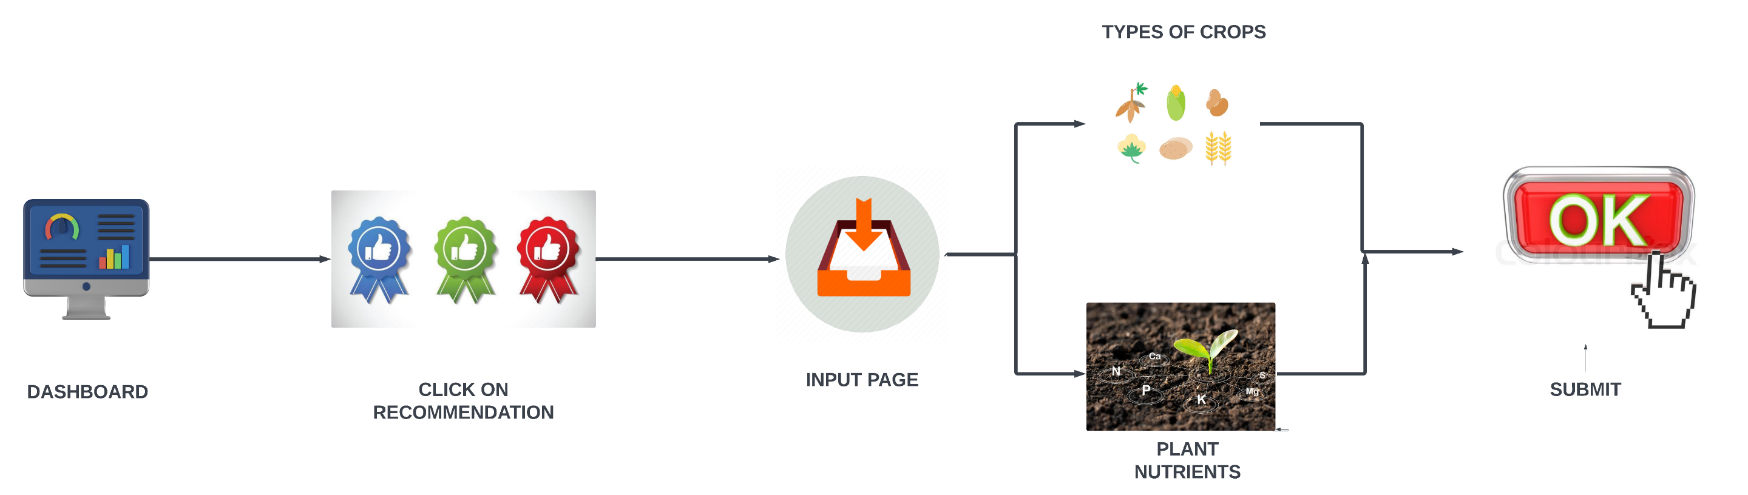
METHODOLOGY

Slide 16
METHODOLOGY
Fertilizer Recommendation System
Developed a model to recommend appropriate fertilizer types and amounts based on soil nutrient levels and crop requirements.
Used decision rules to provide tailored recommendations for different crops.
Predictive Modeling
Employed Random Forest Regressor for yield prediction.
Trained the model on historical yield data, considering factors such as year, district, crop, season, and area.
Predicted future yields with and without soil nutrient adjustments.

Slide 17
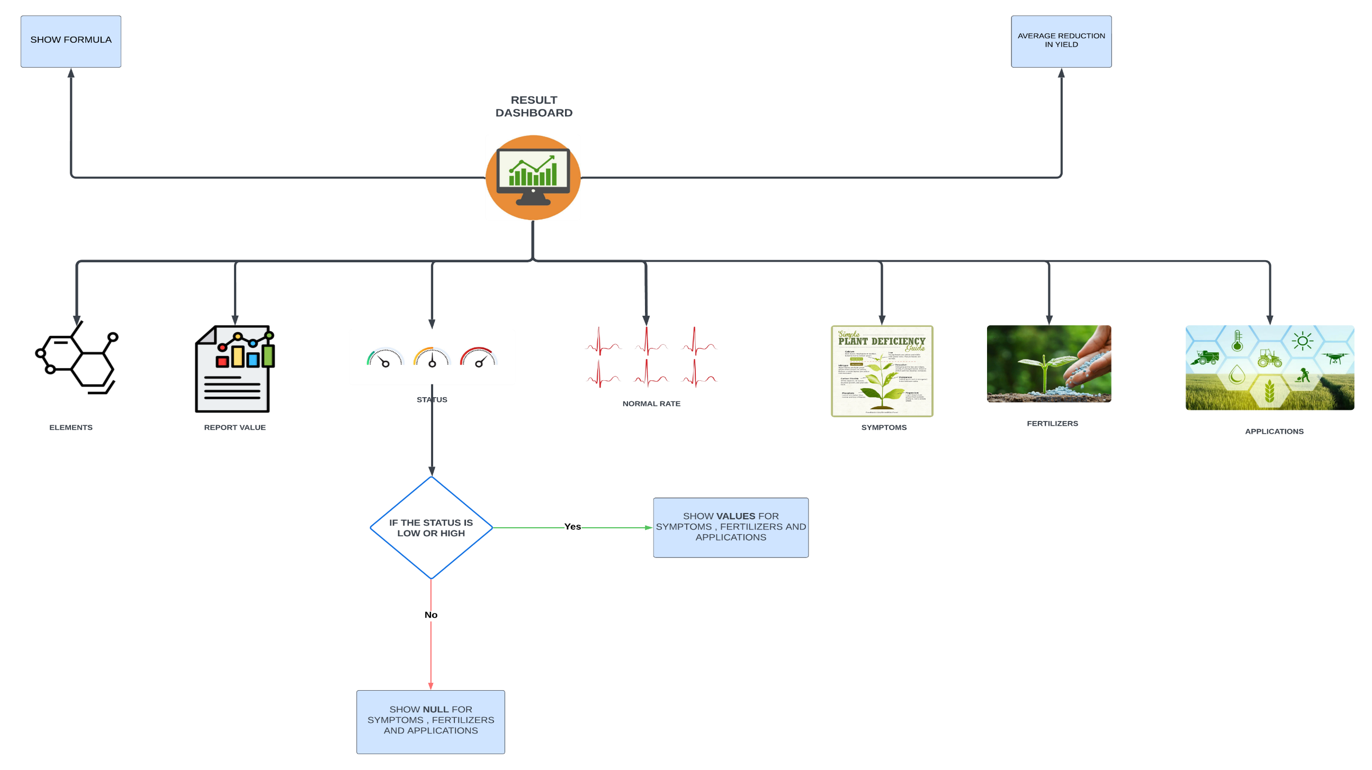
METHODOLOGY

Slide 18
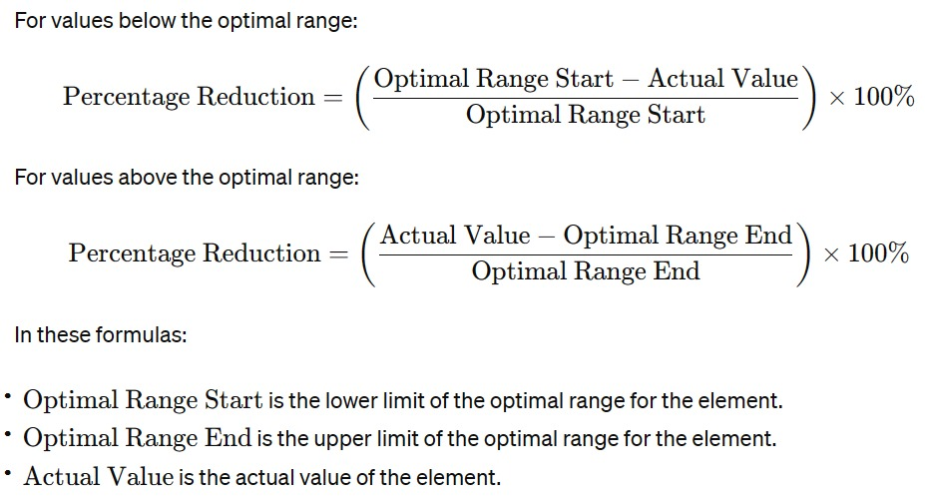
METHODOLOGY

Slide 19
METHODOLOGY
Result Dashboard:
Central hub for displaying soil nutrient status, recommendations, and expected yield reductions.
Elements:
Report Value: Actual measured values of soil elements (e.g., nitrogen, phosphorus, potassium).
Status: Indicates if each element is within the optimal range, below, or above.
Normal Rate: Shows the optimal range for each nutrient to identify deficiencies or excesses.
Symptoms:
Identifies potential crop symptoms due to nutrient imbalances based on soil nutrient status.
Fertilizers:
Recommends specific fertilizers to address identified deficiencies or excesses.
MACHINE LEARNING

Slide 20
METHODOLOGY
Formula:
Show Formula: Displays the calculation used for nutrient status and recommendations.
Understanding Basis: Explains the basis of recommendations and expected impact on yields.
Average Reduction in Yield:
Calculation: Displays expected average yield reduction based on nutrient status.
Understanding Impact: Helps farmers understand the impact of deficiencies or excesses.
Decision Logic:
Correction Needed: Shows values for symptoms, fertilizers, and application methods for imbalances.
No Action Needed: Indicates no action if nutrient status is normal.
Applications:
Specific Recommendations: Guidelines for applying recommended fertilizers (e.g., Apply 40-60 kg N/ha before planting or as top dressing).
Timing and Method: Suggests best times and methods for fertilizer application to maximize uptake and yield.
MACHINE LEARNING

Slide 21
EXPECTED OUTCOME
1. Improved Crop Yields:
Enhanced crop health and productivity through optimized nutrient management, leading to higher yields and better quality produce.
2. Cost Savings for Farmers:
Reduction in fertilizer costs and other resource inputs due to precise, data-driven recommendations, resulting in significant cost savings for farmers.
3. Environmental Benefits:
Minimized environmental impact from overuse of fertilizers, leading to healthier soils and reduced pollution of water sources.
4. Empowered Farmers with Data-Driven Insights:
Increased farmer confidence and decision-making capabilities with access to accurate yield predictions and customized agricultural solutions, ultimately improving farm management and sustainability.

Slide 22
REFERENCES
[1] V.C. Waikar, S.Y. Thorat, A.A. Ghute, P.P. Rajput, M.S. Shinde “IoT and Machine Learning-Based Soil Quality and Crop Yield Prediction” International Research Journal of Engineering and Technology, Volume 9, Issue 3, Pages 190-205, January 2024.
[2] P. Rao, N. Reddy Machine Learning for Soil Fertility and Crop Yield Prediction
International Conference on Agricultural Technologies, Pages 140-150, June 2023
[3] M. Singh, R. Verma Real-Time Soil Quality Analysis and Fertilizer Advances in Agricultural Sciences, Volume 15, Issue 1, Pages 23-40, February 2023.
[4] A. Mehta, V. Kapoor IoT-Based Soil Monitoring and Fertilizer Smart Agriculture Technologies, Volume 5, Issue 4, Pages 65-80, November 2022.
[5] K. Patel, M. Desai, P. Rana Precision Agriculture: Soil Nutrient Analysis Using IoT International Journal of Precision Agriculture, Volume 8, Issue 2, Pages 145-160, March 2022.
[6] S. Kumar, A. Gupta Enhancing Soil Quality Prediction with Deep Learning
AI in Agriculture, Volume 7, Pages 95-110, July 2022.
[7] Nidhi Bangera, Sanjana Bhardwaj, Bhavika Bulani, Anusha Shetty, Asma Parveen I. Siddavatam Smart Farming: Soil and Fertilizer Management with AI Agricultural Informatics, Volume 9, Issue 3, Pages 78-89, September 2021.
[8] D. Jayashree, O. Pandithurai, L. Paul Jasmin Rani, Praveena K. Menon, Mahek V. Beria, S. Nithyalakshmi Fertilizer Recommendation System Using IoT and Machine Learning 3rd IEEE International Conference on Computational Systems and Information Technology for Sustainable Solutions, Pages 120-125, May 2021.
01
02
03
04

Slide 23
THANK YOU

